Slide 1

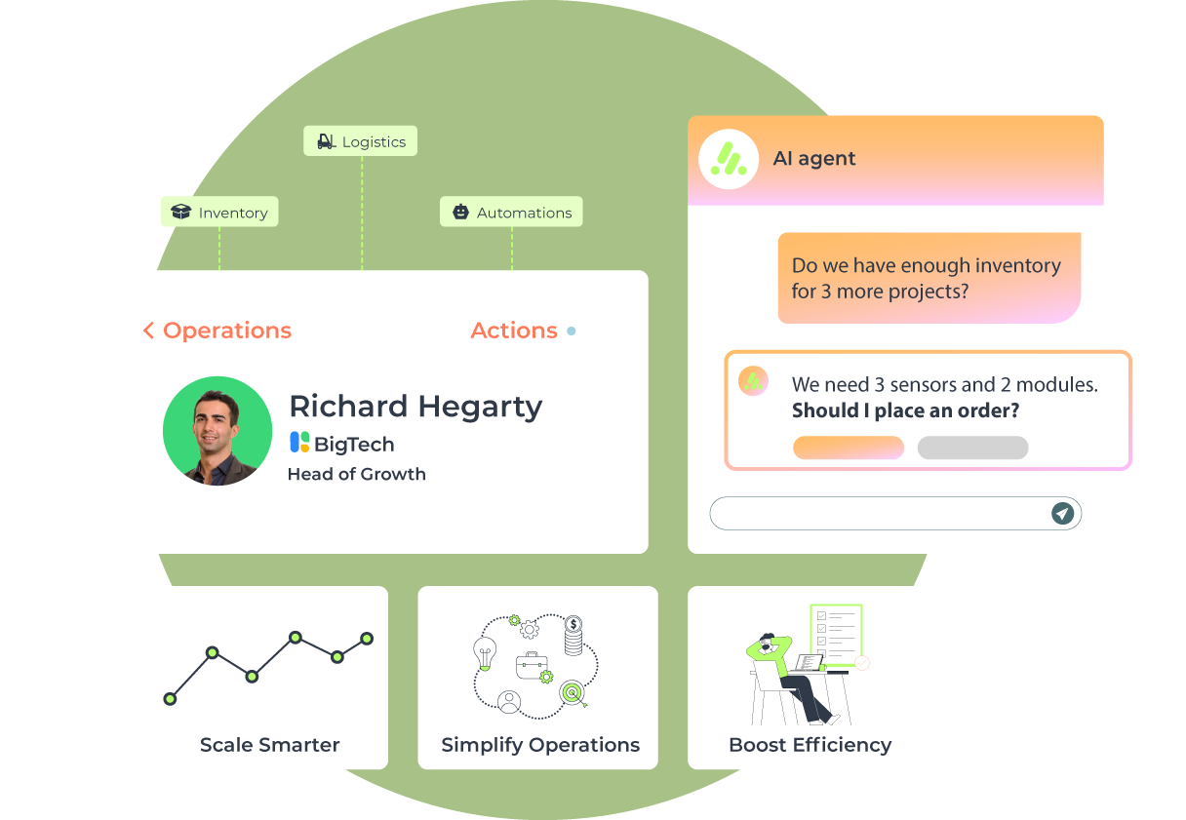
AITSC
Start
About Us
Contact
Contact Us
Technology Solutions Company
Passenger
Safety System
Real-time seat belt detection system that installs easily with seamless hardware integration and smart alerts.
Get Started!

Slide 2
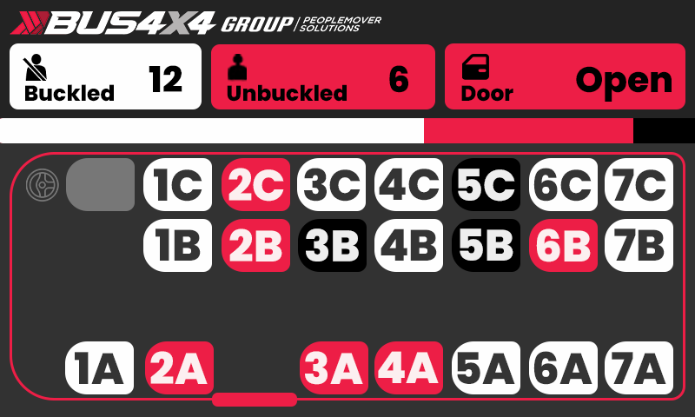
AITSC
Home
About Us
Contact
Search
System Overview.
01
Real-Time Monitoring
Instantly detects and reports unbuckled passengers, enabling operators to take immediate action for onboard safety and reducing liability risks.
A safety solution designed for buses and other passenger transportation vehicles. Its primary function is to monitor seatbelt usage for all passengers and to provide visual and audible alerts if seatbelts are not properly fastened.
02
Visual Dashboard
An intuitive display provides clear visual feedback allowing quick situational awareness.
03
Plug-and-Play Installation
The system offers a fast and hassle-free setup, minimising downtime and installation costs.

Slide 3
Your Company
Home
About Us
Contact
Search
Installation
Install seat and buckle sensors, connect them to the module, and daisy chain modules to the display unit.
Install Sensors
Plug into Module
Link to Display
Install seat and buckle sensors on each seat.
Plug seat sensors into their allocated plug in the module.
Daisy chain modules and connect to the display unit.

Slide 4
Your Company
Home
About Us
Contact
Search
Research and Ideation
A small river named Duden flows by their place and supplies it with the necessary regelialia. It isparadisematic.
Timeline of Innovation.
User Testing
A small river named Duden flows by their place and supplies it with the necessary regelialia. It isparadisematic.
Unlocking Blockchain Potential in Key Industries.

Slide 5
AITSC
Home
About Us
Contact
Search
Installation
Install seat and buckle sensors, connect them to the module, and daisy chain modules to the display unit.
Financial Institutions
Healthcare Providers
Technology Startups
When she reached the first hills of the Italic Mountains had.
When she reached the first hills of the Italic Mountains had.
When she reached the first hills of the Italic Mountains had.

Slide 6
Your Company
Home
About Us
Contact
Search
Introduction to Blockchain.
A small river named Duden flows by their place and supplies it with the necessary regelialia.
Exploring the Core of Blockchain Breakthroughs.
Which roasted parts of sentences.
256
300+
Professionals
Customer

Slide 7
Your Company
Home
About Us
Contact
Search
Current Challenges Stalling Progress.
Security Risks
2028
2030
1000+
Blockchains Exist
Overcoming Barriers Slowing Blockchain's Full Potential.
Scalability Issues
Regulatory Uncertainty
When she reached the first hills of the Italic Mountains, she had a last view back.
Even the all-powerful Pointing has no control about the blind texts.

Slide 8
Your Company
Home
About Us
Contact
Search
Redefining Problem-Solving.
Decentralization
When she reached the first hills of the Italic Mountains, she had a last view back.
Enhanced Security
Global Accessibility
When she reached the first hills of the Italic Mountains, she had a last view back.
When she reached the first hills of the Italic Mountains, she had a last view back.

Slide 9
Your Company
Home
About Us
Contact
Search
At the Core of Our Innovation.
87.5%
Uptime Guaranteeing
User-Centered Design
Scalable Technologies
When she reached the first hills of the Italic Mountains, she had a last view back.
When she reached the first hills of the Italic Mountains, she had a last view back.
87%
Sustainable Impact
112+
When she reached the first hills of the Italic Mountains, she had a last view back.
Our Great Progress
Users Happy

Slide 10
Your Company
Home
About Us
Contact
Search
Pricing Strategy.
Professional Plan
Basic Plan
$120
Enterprise Plan
/Month
$65
When she reached the first hills of the Italic.
$200
/Month
/Month
When she reached the first hills of the Italic.
When she reached the first hills of the Italic.
Enhanced Security
Enhanced Security
Transparency & Trust
Enhanced Security
Transparency & Trust
Improved Traceability
Transparency & Trust

Slide 11

Your Company
Home
About Us
Contact
Search
Competitor One
Competitor Two
When she reached the first hills of the Italic Mountains had.
When she reached the first hills of the Italic Mountains had.
Competitive Landscape.
Positioning for Success in a Dynamic Blockchain Ecosystem.

Slide 12

Your Company
Home
About Us
Contact
Search
Cutting-Edge Technology
Our Key Advantages.
Even the all-powerful Pointing has no control about the blind texts.
Tailored Solutions
Unlocking Success Through Our Distinctive Strengths That Set You Apart.
Even the all-powerful Pointing has no control about the blind texts.
Enhanced Security
When she reached the first hills of the Italic Mountains, she had a last view back.

Slide 13
Your Company
Home
About Us
Contact
Search
A Journey Through Innovation: Milestones of Blockchain Evolution.
Expansion and Growth
Future Directions
A small river named Duden flows by their place and supplies with necessary.
A small river named Duden flows by their place and supplies with necessary.
15 Years
Over 1,000
Since the launch
Apps Developed

Slide 14
Your Company
Home
About Us
Contact
Search
Let’s Take A Break.
Time to Recharge.
Positioning for Success in a Dynamic Blockchain Ecosystem.

Slide 15
Your Company
Home
About Us
Contact
Search
Revenue Projections.
2028
A Journey Through Innovation: Milestones of Blockchain Evolution.
Revenue
$3M
Net Profit
$1.8M
2031
Revenue
$2M
Net Profit
$700K
Growth Rate
86%
2033
Revenue
$1M
Net Profit
$500K

Slide 16

Your Company
Home
About Us
Contact
Search
Key Partnerships Secured.
10+
Powering Growth Through Partnerships.
Global Suppliers
Infrastructure Provider
Payment Solutions
Enterprise Adoption
Even the all-powerful Pointing has no control about the blind texts.
When she reached the first hills of the Italic Mountains, she had a last.
Even the all-powerful Pointing has no control about the blind texts.

Slide 17
Your Company
Home
About Us
Contact
Search
Future-Ready Blockchain.
87%
Scalability and Flexibility
When she reached the first hills of the Italic Mountains, she had a last view back.
Our Great Progress
User Empowerment
87.5%
When she reached the first hills of the Italic Mountains, she had a last view back.
Uptime Guaranteeing

Slide 18
Your Company
Home
About Us
Contact
Search
What People Are Saying About Us.
Madha K.
Student
A small river named Duden flows by their place and supplies it with.
Sarah Miwa.
Student
A small river named Duden flows by their place and supplies it with the necessary regelialia. It isparadisematic.
4.7/5
450+
Rating on Apps
Customer

Slide 19
Your Company
Home
About Us
Contact
Search
Targeting Key Industries.
Powering Growth Through Partnerships.
Financial Services
Supply Chain
Healthcare
Even the all-powerful Pointing has no control about the blind texts.
When she reached the first hills of the Italic Mountains, she had a last.
Even the all-powerful Pointing has no control about the blind texts.

Slide 20
Your Company
Home
About Us
Contact
Search
Innovative Technology
User-Centric Design
Strong Partnerships
When she reached the first hills of the Italic Mountains, she had.
Even the all-powerful Pointing has no control about the blind texts.
Even the all-powerful Pointing has no control about the blind texts.
Competitive Edge.
Proven Uptime
90%
When she reached the first hills of the Italic Mountains, she had.
Powering Growth Through Partnerships.

Slide 21
Your Company
Home
About Us
Contact
Search
Founders and Key Personnel.
Jesse McGraw
As Head CEO
When she reached the first hills of the Italic Mountains, she had.
Best CEO
10+ Years
Of year
Experience
Cass Monroe
Sadie Thomson
Olivia Hall
As Head Wrangler
As Field Supervisor
As Field Supervisor

Slide 22
Your Company
Home
About Us
Contact
Search
Let’s Take A Break.
Pause for a Moment, Recharge for What’s Next.

Slide 23
Your Company
Home
About Us
Contact
Search
Financial Projections.
Mapping the Future: Where Vision Meets Numbers.
2028
2031
2033
Net Income
Assumptions
Appendices
Profit
A small river named Duden flows by their place and supplies it with the necessary regelialia.
When she reached the first hills of the Italic Mountains she had.
When she reached the first hills of the Italic Mountains she had.
When she reached the first hills of the Italic Mountains she had.

Slide 24
Your Company
Home
About Us
Contact
Search
Exit Strategy.
Initial Public Offering
Acquisition
Their pronunciation and their most comsae realizes why a new common.
Merger
Their pronunciation and their most comon. Everyone realizes.
Their pronunciation and their most common words. Everyone realizes why a new common.
$50M+
in Annual Recurring

Slide 25

Your Company
Home
About Us
Contact
Search
Traction.
Revenue Growth
When she reached the first hills of the Italic Mountains she had.
Progress You Can Measure, Impact You Can See.
Annual Recurring
When she reached the first hills of the Italic Mountains she had.
Transactions Proces
632+
$50M+
When she reached the first hills of the Italic Mountains she had.
Active Clients
Annual Recurring

Slide 26
Your Company
Home
About Us
Contact
Search
Risk and Mitigation.
$10M
When she reached the first hills of the Italic Mountains she had.
Identify Risk
Control Risk
When she reached the first hills of the Italic Mountains she had.
When she reached the first hills of the Italic Mountains she had.

Slide 27
Your Company
Home
About Us
Contact
Search
Funding Requirements.
Use of Founds
14
12
Expense Breakdown
10
A small river named Duden flows by their place and supplies it with the necessary regelialia. It isparadisematic.
8
6
4
2
0
Expenses
Acquisition
Marketing
Development

Slide 28
Your Company
Home
About Us
Contact
Search
Customer Acquisition.
Nurturing
A small river named Duden flows by their place and supplies it with the necessary regelialia..
Expanding Our Reach, One Customer at a Time.
Interest
Awareness
Purchase
When she reached the first hills of the Italic Mountains she had.
When she reached the first hills of the Italic Mountains she had.
When she reached the first hills of the Italic Mountains she had.

Slide 29
Your Company
Home
About Us
Contact
Search
Let’s Clarify and Connect.
When she reached the first hills of the Italic Mountains she had.
Got Any Questions?

Slide 30

Home
About Us
Contact
Search
Thank You For Your Attention
Contact Us
123 Main Street, Any city, State Country 123
www.example.com
+123 456 7890
example@mail.com

